Slide 1
Creating a Tool for Facilitating and Researching Human Annotation of Musical Patterns
Authors
Presenter
Stephan Wells
s.b.wells@students.uu.nl
Anja Volk
A.Volk@uu.nl
Iris Yuping Ren
y.ren@uu.nl
Stephan Wells
Notes:
Stephan Wells
Master’s student at Utrecht University studying Game & Media Technology
Presenting my Master’s thesis called Creating a Tool for Facilitating and Researching Human Annotation of Musical Patterns
A lot to unpack

Slide 2
Creating a Tool for Facilitating and Researching Human Annotation of Musical Patterns
Authors
Presenter
Stephan Wells
s.b.wells@students.uu.nl
Anja Volk
A.Volk@uu.nl
Iris Yuping Ren
y.ren@uu.nl
Stephan Wells

Slide 3

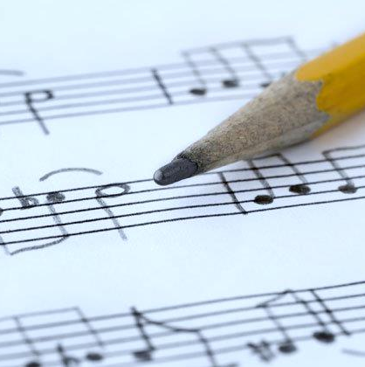

Areas
Pattern Recognition
Music Annotation
HCI
Notes:
Wanted to start by talking about the three different areas that the thesis touches on and giving some brief background to make sure everyone’s on the same page.

Slide 4
Areas
Pattern Recognition
Music Annotation
HCI
What is ?

Slide 5
What is Pattern Recognition?
What is Pattern Recognition?

Slide 6
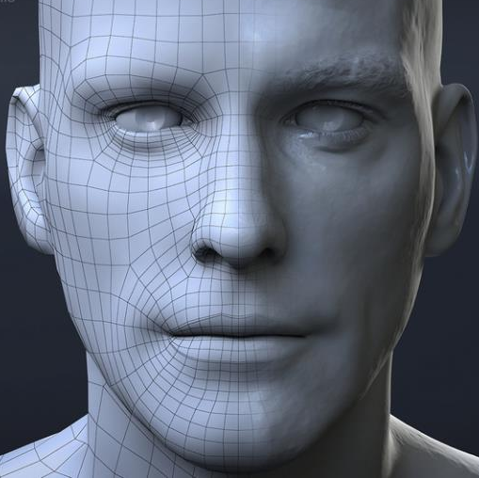
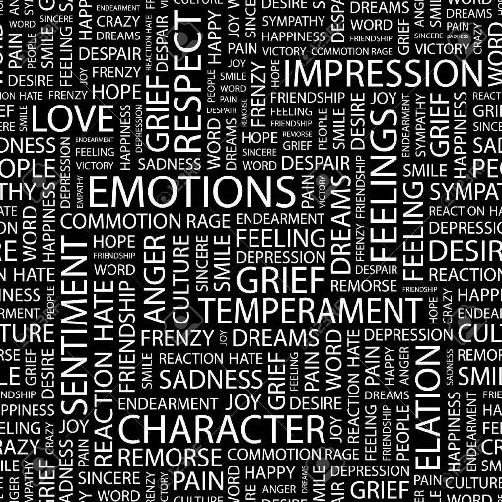
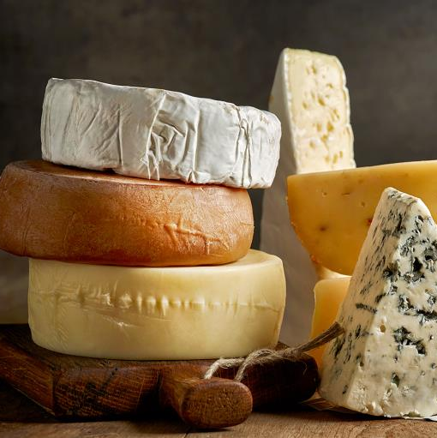

What is Pattern Recognition?
The automated discovery of regularities in data.
Patterns are everywhere:
The human face.
Language.
Smells.
Behaviour.
The automated discovery of regularities in data.
Patterns are everywhere:
The human face.
Language.
Smells.
Behaviour.
Patterns are how we understand the world around us.
Patterns are how we understand the world around us.
Notes:
Pattern recognition is often defined in the research as “the automated discovery of regularities in data”. But what is a regularity?
We see regularities around us all the time. There’s a pattern to the human face: eyes, nose, mouth. Languages are just patterns of alphabetical letters. We see patterns in smells that we can use to distinguish what we’re smelling. Human or animal behaviour follows patterns.
Ultimately, the point I really want to drive home is that patterns are how we understand the world around us.
If I look at that window over there, I don’t know it’s a window because I‘m looking at every different grain of dust on it, every tiny constituent element of it, the materials used to make it, etc. I know it’s a window because it matches my mental pattern of what a window is: it’s on a wall, it’s transparent, it allows people to look outside and most allow outsiders to look in as well. Windows can come in many different varieties, but because of this conception of a window in my head, as long as windows follow the pattern, I’ll pick up that they’re windows.

Slide 7
What is Pattern Recognition?
Humans are exceptionally good at pattern recognition.
We can handle basic domains like a stream of binary symbols¹.
We can handle complex domains like visual object recognition².
Music is no exception³.
We want computers to develop an understanding of data just like we do.
¹ J. Feldman, “Simulation of behaviour in the binary choice experiment”, 1961
²J. J. DiCarlo et al., “How does the brain solve visual object recognition?”, 2012
³D. Deutsch & J. Feroe, “The internal representation of pitch sequences in tonal music”, 1981
Notes:
It turns out that humans are excellent at pattern recognition. We can find patterns in very basic domains like a stream of ones and zeroes or a stream of circles and triangles, and we can even handle complex domains like visual object recognition, just like I did with the window. The topic of my thesis very much revolves around music, and of course music is no exception. Studies show that even when we’re infants we’re able to identify patterns in music. We want computers to develop something of an understanding of patterns in data just like we do. That’s of course a drastic oversimplification of the goal of pattern recognition but it should help give you all an idea of what we’re after.

Slide 8

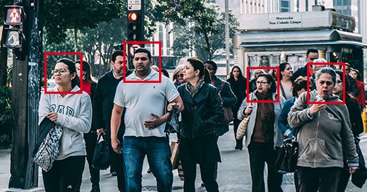
Different Kinds of Pattern Recognition
Unsupervised
Supervised
MODEL
MODEL
MODEL
MODEL
Now able to generalise!
Notes:
Pattern recognition typically falls under one of two types: unsupervised or supervised. In unsupervised pattern recognition, you start with a computational model. This is a fancy way of meaning a bunch of algorithms or functions that take an input and give you an output. The model is given data, and in unsupervised pattern recognition, it’s told to find patterns or structure within the data on its own without being given any examples of what it might need to look for. An example of where this might be used is market trend analysis, where you want a model to pick up on trends or patterns without necessarily indicating exactly what you want it to find.
On the other hand, in supervised pattern recognition, you know what you’re looking for. This type of pattern recognition is closely related to machine learning or indeed how we tend to learn things as humans, where you start with a model once again, and feed it data. This time, the data is already labelled. We know what kind of patterns we’re after. We keep feeding it this labelled training data in the hope that it will learn to be able to detect patterns like what we’re showing it on its own. An example application here would be face detection, where you start by giving a learning model a large database of images with faces already detected and marked by humans, and then test how good it is by giving it unseen images to find faces in.
In this thesis, we’re mostly concerned with supervised pattern recognition.

Slide 9
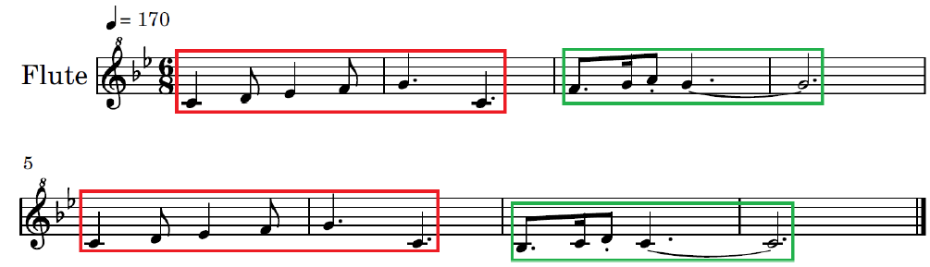
Patterns in Music
A musical pattern is a characteristic melodic segment of a piece of music that has multiple exact or inexact repetitions in the piece¹.
Repeats more than once in the music.
Is made up of multiple melodic notes.
Should be no longer than a musical phrase.
A musical pattern is a characteristic melodic segment of a piece of music that has multiple exact or inexact repetitions in the piece¹.
Repeats more than once in the music.
Is made up of multiple melodic notes.
Should be no longer than a musical phrase.
¹ T. Collins, “MIREX: Discovery of repeated themes & Sections”, 2019. Link: https://tinyurl.com/mirex2019
¹ T. Collins, “MIREX: Discovery of repeated themes & Sections”, 2019. Link: https://tinyurl.com/mirex2019
Notes:
Patterns show up in music as well, and that’s going to be our main focus for today. We define a musical pattern as a “characteristic melodic segment of a piece of music that has multiple exact or inexact repetitions in the piece.”. So to break that down, the kind of patterns we’re after should repeat more than once in the music – and that’s important: we assume that a segment of music isn’t quite important for our purposes if it doesn’t repeat more than once. They have to be made up of multiple musical notes that together are no longer than a musical phrase. This means that entire sections of music aren’t necessarily patterns, nor are small collections of 2-3 notes.
The image on the screen is a very basic example of musical patterns, where the red boxes mark patterns that repeat exactly, and the green boxes mark patterns that repeat, but inexactly.

Slide 10
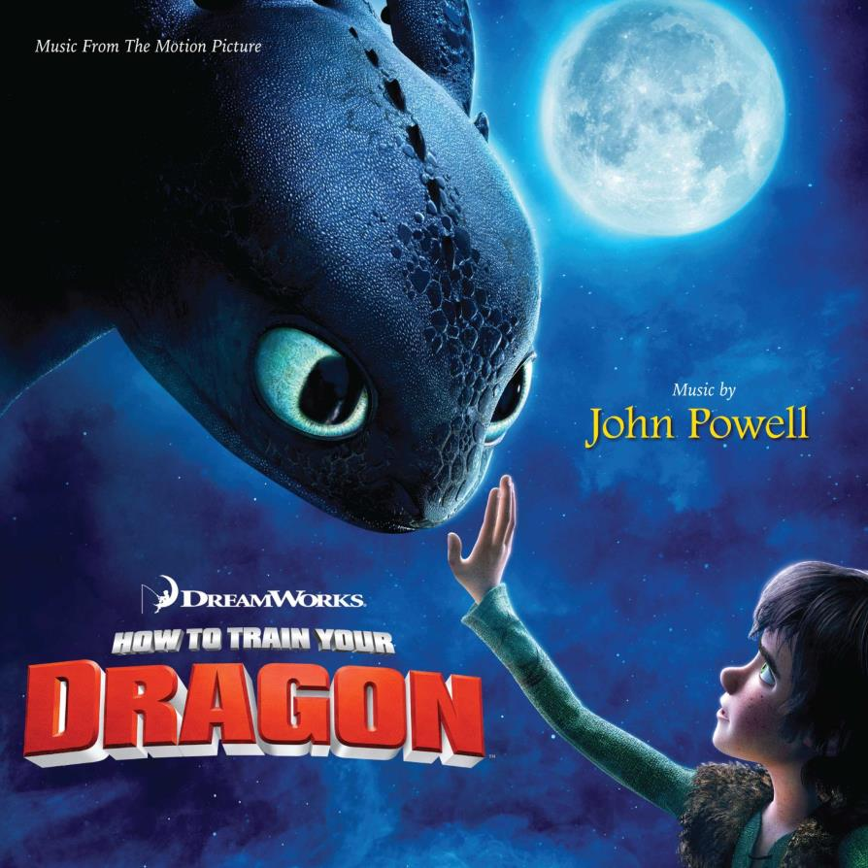
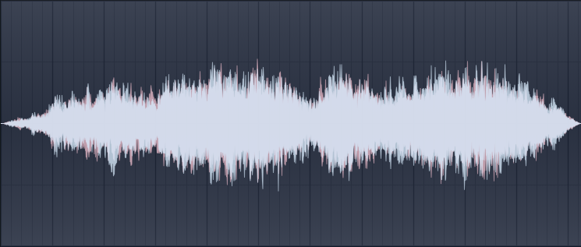
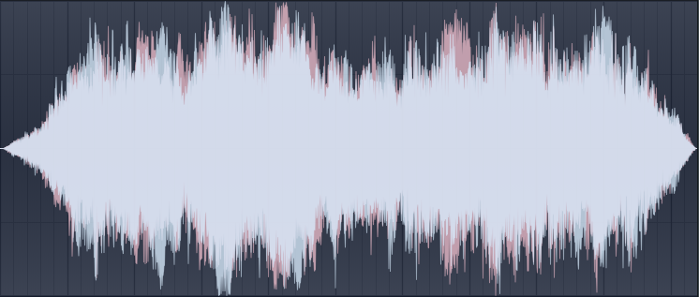

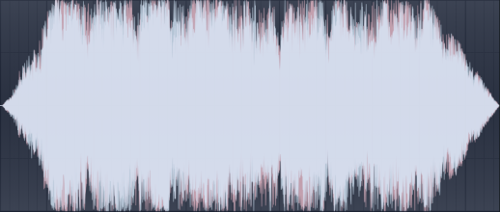
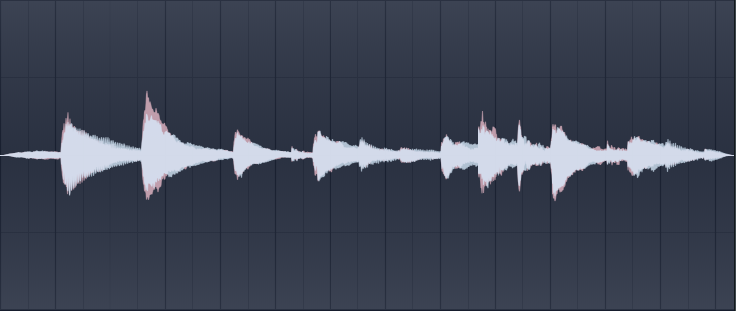
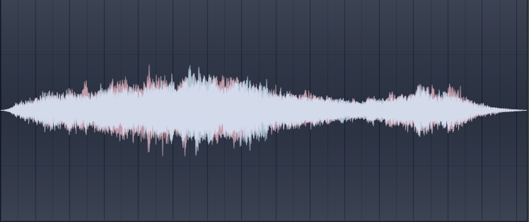
Patterns in Music
Example: leitmotif.
1)
2)
3)
4)
5)
Notes:
A more complex real-world example of patterns would be the idea of a leitmotif. This musical technique is strongly associated with the composer Richard Wagner, who popularised the idea of creating short melodic themes that describe a character, a situation, a place, or even an idea. These melodic themes would repeat many times throughout a soundtrack, to the point where listeners would start to associate these themes or motifs with the thing that they’re describing. This technique is used like crazy nowadays, especially in film soundtracks, and I can give an example of one of my favourite film soundtracks, the soundtrack from How to Train your Dragon.
I’ll be showing you different occurrences of one of the leitmotifs that shows up many times in the soundtrack. I want you all to listen closely to the melody and see if you can pick it up in the different variations I’ll be showing you all. Here’s the leitmotif playing at the very start of the film.
And here it is playing in a later track from the soundtrack. Here it is once again, in a different key, but still the same melody, playing shortly afterwards. And here it is at the end of the film, playing in a very different setting from the previous variations. Despite the different instrumentation, pitches, tempos, and so on, we’re still able to pick up on this leitmotif. As a final example, listen to this more ominous-sounding variation that is in a minor key and has some pretty significant note differences. Keen listeners should still be able to make out the leitmotif.
So here is a very practical and intentional version of musical patterns used in a film score.

Slide 11
Patterns in Music
Why are musical patterns useful?
They form part of the fundamental structure of a piece of music¹.
They see applications in music information retrieval, such as:
Music classification and compression².
Music similarity³.
Ultimately, they are a way for us to analyse music at a higher level of abstraction.
Why are musical patterns useful?
They form part of the fundamental structure of a piece of music¹.
They see applications in music information retrieval, such as:
Music classification and compression².
Music similarity³.
Ultimately, they are a way for us to analyse music at a higher level of abstraction.
³ A. Volk & P. Van Kranenburg, “Melodic similarity among folk songs: An annotation study on similarity-based categorization in music.”, 2012
² P. Boot et al., “Evaluating the role of repeated patterns in folk song classification and compression.”, 2016
³ A. Volk & P. Van Kranenburg, “Melodic similarity among folk songs: An annotation study on similarity-based categorization in music.”, 2012
¹ I. Bent & W. Drabkin, “Analysis”, 1987
² P. Boot et al., “Evaluating the role of repeated patterns in folk song classification and compression.”, 2016
¹ I. Bent & W. Drabkin, “Analysis”, 1987
Notes:
Now I want to talk about why musical patterns such as what we’ve seen so far are useful. In previous research, musical patterns have been said to form part of the fundamental structure of a piece of music. Musicians use repetition all the time to formulate structure and meaning in their music, so clearly we can consider patterns an important feature of music.
On top of that, in the field of music information retrieval, where we’re concerned with researching technologies and meta information to do with music, these patterns actually see a lot of use. We can use them to form the basis of systems that can classify music, compress it, or quantify similarity between different pieces of music. This kind of information could be the backbone for music recommendation systems or music search engines.
Ultimately, musical patterns are a way for us to analyse music at a higher level of abstraction.

Slide 12
Areas
Pattern Recognition
Music Annotation
HCI
Notes:
Next, I’ll talk a bit about music annotation.

Slide 13
Areas
Pattern Recognition
Music Annotation
HCI
What is ?

Slide 14
What is Music Annotation?
What is Music Annotation?

Slide 15
What is Music Annotation?
Music annotation in this context is the process of identifying and marking musical patterns.
Common information to include in an annotation:
The start and end boundaries of the annotation.
An identification (such as pattern number).
A confidence level.
This process can be manual or automatic.
Music annotation in this context is the process of identifying and marking musical patterns.
Common information to include in an annotation:
The start and end boundaries of the annotation.
An identification (such as pattern number).
A confidence level.
This process can be manual or automatic.
Notes:
Strictly speaking, when we say music annotation, we mean any form of marking or note-taking that is done on top of already existing music. In our context though, when we say music annotation we mean the process of finding and marking patterns in music. Generally, a pattern annotation will consist of the start and end boundaries or start time and duration of a pattern in the piece of music. It will sometimes have an identification, like pattern 1, pattern 2, or maybe the third occurrence of pattern 5. Finally, more often than not we include a confidence level with a pattern annotation, which indicates how confident we are that the pattern we’ve annotated is actually what we’re looking for.
This music annotation process can be manual or automatic.

Slide 16
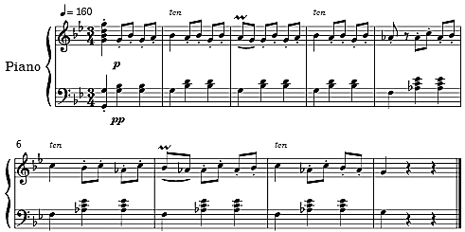
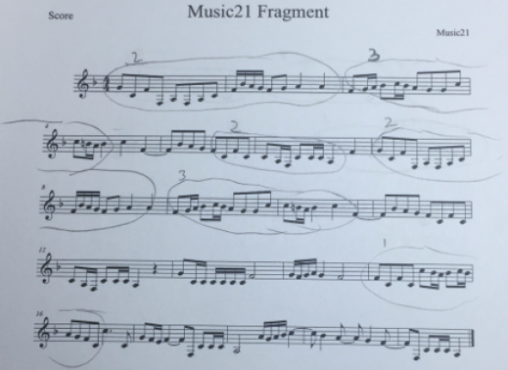
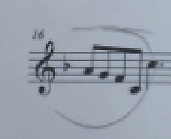
What is Music Annotation?
Automatic Annotation
Manual Annotation
Manual annotation is the process of pattern discovery and annotation done by humans.
Challenges:
Pen-and-paper annotation is imprecise.
Long digitisation times if done on pen and paper.
The annotation process is subjective¹.
Human annotation isn’t scalable!
1
"annotations": [
{
"sandbox": {},
"duration": 38400,
"data": [],
"namespace": "pattern",
"time": 0,
"annotation_metadata": {
"corpus": "",
"validation": "",
2
¹ T. Collins et al., “Modeling pattern importance in Chopin's mazurkas”, 2011
Notes:
So, manual annotation is the discovery and annotation of patterns done by humans, by you and I. Typically, you would have someone sit down with music in front of them, often in the form of a physical paper of sheet music, and they would scribble on the paper to mark patterns and maybe include confidence levels or other information. You can see this in the image on the screen, which is pattern annotation done on an excerpt of music from Bach.
We run into various problems in manual annotation. For starters, pen-and-paper annotation is imprecise. To give an example, I’ll zoom in to one of the bars of the music. Over there, whoever annotated it circled up till the end of the pattern, but where does the circle stop? The circle doesn’t quite cover the entire last note, so do we include it or not?
Secondly, manual annotation in this form, as in scribbled sheets of music, is not exactly that easy for a computer to digest. We will want to manually digitise the annotation in some form, which takes time and is very tedious.
Finally, the annotation process when done by humans is subjective. Humans don’t always agree on what constitutes a pattern or occurrence of a pattern and what doesn’t. This is backed up by a study performed by Tom Collins, where they get some music by Chopin and annotate different segments of it, then ask trained music students to decide how important each annotated segment is. They disagreed pretty wildly about this, and they’re trained musicians.
To give an example on how annotators might disagree, let’s take a look at this piece of music called Danse Macabre by Camille Saint Saens. We’re going to give it a close listen. Many of you probably heard that it’s made up of two repetitions of the same melodic idea, 1 and 2. We’ll hear them again slowly. You might want to annotate these as two occurrences of the same pattern, but keen listeners might have noticed that the ending of each phrase is different. There’s sort of a question answer thing going on here, right?
So one annotator might say “That’s fine, that’s only a minor difference. I’m going to annotate this part as one entire occurrence, and this part as another entire occurrence.”. Another annotator might say no, the ending is different so we’re going to leave out the ending part of each occurrence from the annotation. But then what will we do with that ending part if it shows up later on in the music, which, spoiler alert, it does? Do we ignore it? Do we annotate them as two separate patterns? Is that too small to be a pattern? Questions like these are very valid questions that music annotators will struggle with.
The point here is, human annotation isn’t scalable, at least not in its current form.

Slide 17
What is Music Annotation?
Automatic Annotation
Automatic annotation is the process of pattern discovery and annotation done by algorithms.
Automatic pattern discovery tends to find too many patterns¹.
Humans are still better at finding relevant or salient patterns².
There’s a lack of ground truth to train automatic methods on.
Bottom line: we still need human annotations.
¹ D. Meredith., “Music analysis and point-set compression”, 2015
² P. Boot et al., “Evaluating the role of repeated patterns in folk song classification and compression.”, 2016
Notes:
So why not do it with computers instead? Computers can compute patterns very quickly, in bulk, and don’t have the seemingly negative human bias influencing what kind of patterns they find, right? Well, no, it’s not that simple. Automatic pattern discovery tends to fall into the trap of finding far too many patterns. You can have an unsupervised model find exact or transposition-invariant repetitions of collections of notes, but that would find hundreds of collections of patterns in a piece of music only a dozen or two bars long, whereas a human expert would only find a few.
As it turns out, humans are just better at finding more useful or salient patterns, which was shown in previous research that compared the performance of human-annotated musical patterns with automatically-discovered musical patterns on music information retrieval tasks and found that humans really do it better, .
So why not just create a supervised learning model that takes human-annotated data, learns from it, and then annotates like humans do? Again, easier said than done. A big problem here is that there’s a lack of ground truth data to train automatic methods on. If we were to do image classification, handwriting recognition, or face detection, for example, we could find plenty of generally non-subjective, gold-standard, properly labelled databases out there to train our models on, but due to the issues I mentioned earlier, that isn’t so much the case for musical patterns.
The bottom line here is that we still need human annotations.

Slide 18
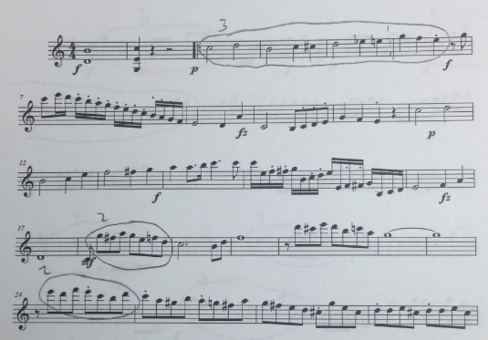




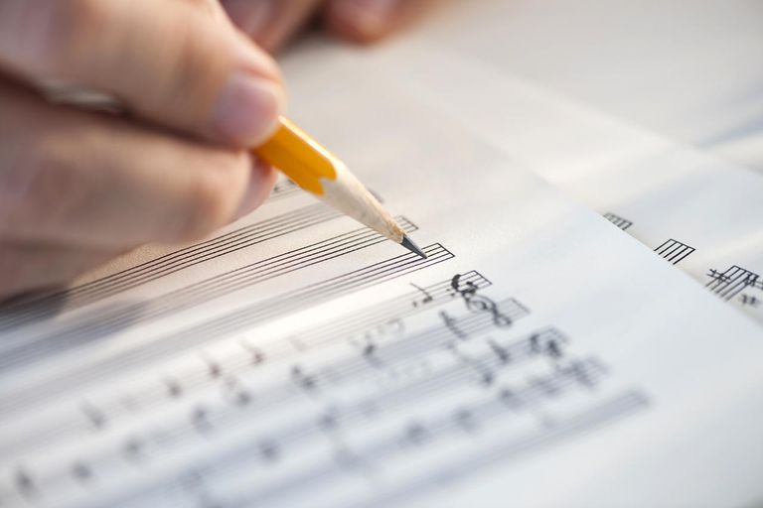
Recap
Patterns, are short melodic segments of music that have multiple exact or inexact occurrences throughout a piece of music.
They’re useful as musical features or training data for many applications of music information retrieval.
There are two ways to discover and annotate patterns: manual, and automatic.
Most manual annotation is done using pen and paper which has many drawbacks, but we need more human annotations to research and develop automatic methods.
Compression
Classification
Training Data
Notes:
Quick recap: Patterns are short repeating segments of music. They’re useful for research and practical application. We can find them and annotate them manually or automatically. Automatic methods struggle to annotate patterns as well as humans do, but we need more research and generation of human pattern annotations to research and develop automatic methods.

Slide 19
Areas
Pattern Recognition
Music Annotation
HCI
Notes:
This is where human computer interaction comes in.

Slide 20
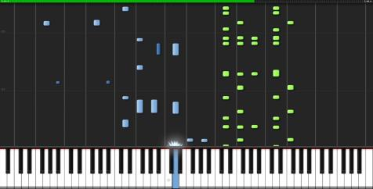

Methodology
Solution: digital music annotation.
Two types of digital music:
Solution: digital music annotation.
Two types of digital music:
Audio
Audio
Symbolic
Symbolic
.mp3
.wav
.wav
.ogg
.mp3
.ogg
MIDI
MIDI
Made out of samples of the physical sound’s waveform.
Supports any kind of audio, from music to sound effects to vocal conversation.
Made out of events that describe musical information.
Allows you to see the musical notes that a piece consists of.
Made out of samples of the physical sound’s waveform.
Supports any kind of audio, from music to sound effects to vocal conversation.
Made out of events that describe musical information.
Allows you to see the musical notes that a piece consists of.
Notes:
My proposed method is to digitise the process of music annotation: allow people to annotate music digitally instead of on pen-and-paper. Before we get into that, we need to quickly understand the two types of digital music. We’ve got audio, which is the form most of us in this room will be familiar with. This is your audio files on Spotify, your film and game soundtracks, or your embarrassing recording of yourself singing that you’re not sure why you haven’t deleted yet. This kind of music is done by sampling the physical sound’s waveform at regular intervals to make a faithful digital recreation of sound.
On the other hand, you have symbolic music. This usually comes in the form of MIDI files, and unlike with audio files, MIDI files are made out events that describe musical information. For example, you might have an event that describes the tempo of the music or the time signature, or an event that says “okay at this precise point in the music a piano note starts playing”. Since we’re not saving audio but musical information, we’re now able to see the musical notes that a piece consists of, and that’s great for our purposes of annotating music, so this is why we’re going be using symbolic music files, or MIDI files, as music to annotate.

Slide 21
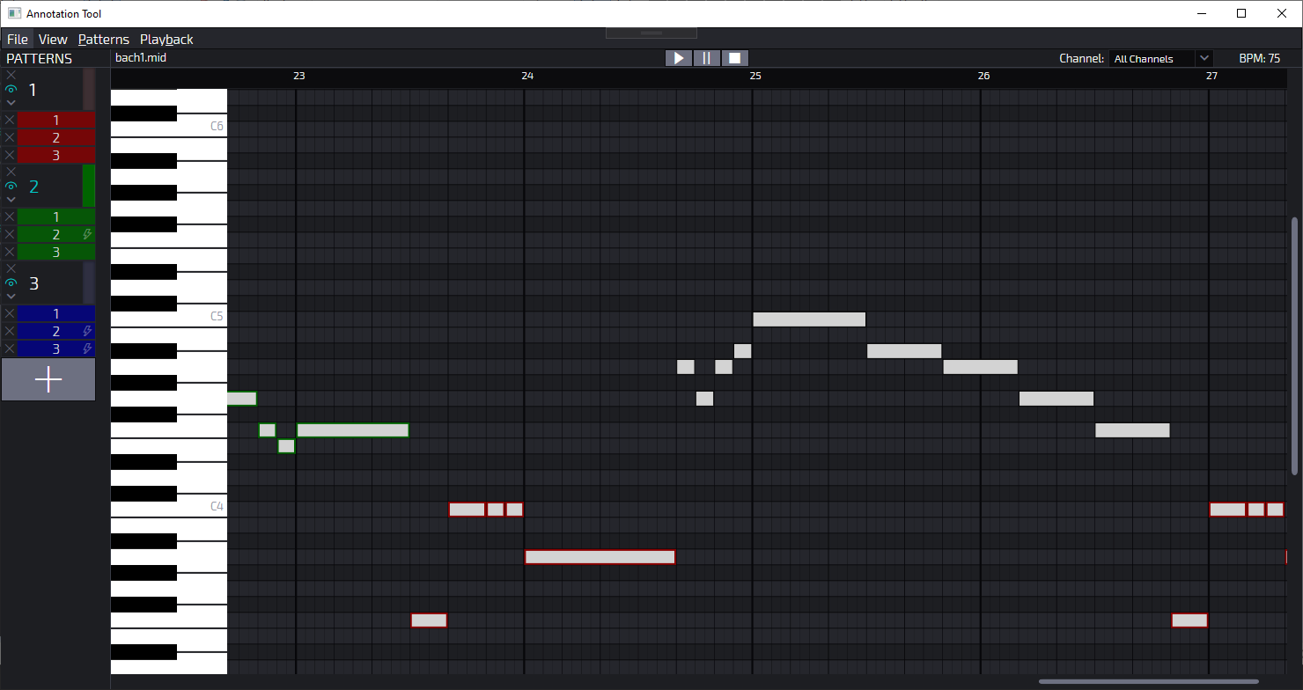
Methodology
We created a software tool that can open symbolic music (.mid) files and allow annotators to mark occurrences of patterns.
We created a software tool that can open symbolic music (.mid) files and allow annotators to mark occurrences of patterns.
O
AN
O
AN
M
M
IC
IC
ANNOTATE MUSIC
ANNOTATE MUSIC
Notes:
The focal point of this thesis is the creation of a software tool that is able to open symbolic music files and allow annotators to mark occurrences of patterns. It’s called ANOMIC, which stands for Annotate Music, and here is the interface. There’s a lot going on here so I’ll quickly break it down. The very left pattern has three colour-coded patterns: red, green, and blue. Each pattern has three occurrences. On the right, we see what’s called a piano roll interface, where we have piano keys laid out vertically and then bars on the right to indicate musical notes. The bars’ pitch is indicated by their vertical position, their time in the music indicated by their horizontal position, and the duration of the note indicated by the length of the bar. Up top we can see playback buttons, and at the top left we have some menus for settings and other features.

Slide 22
Methodology
Features of ANOMIC:
Open-source¹ WPF application written in C# and XAML.
Uses a zoom-supported piano roll interface to visualise MIDI files.
Supports flexible audio playback with a tracker to visualise music position.
Provides a customisable interface with the ability to show, hide, collapse, or expand patterns, occurrences, and MIDI channels.
Supports automatic occurrence matching.
Ability to load and save annotations to the popular, standardised JAMS format².
¹ https://tinyurl.com/anomicrepo
² E. J. Humphrey et al., “JAMS: A JSON annotated music specification for reproducible MIR research.”, 2014
Notes:
The tool is open-source and written in C# and XAML using a piano roll interface to visualise MIDI files. It allows the user to play the MIDI files with a tracker showing which note is being played, show or hide different parts of the interface to suit the user’s needs, and it supports a feature called automatic occurrence matching, which allows users to, after finding the initial occurrence of a pattern, right-click on that occurrence to find transposition-invariant exact matches of that occurrence automatically. Finally, we have the ability to load and save annotations using a standardized JAMS format, which is a JSON-based protocol for saving music annotations that’s used in music information retrieval research.

Slide 23
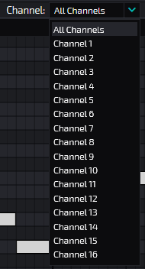
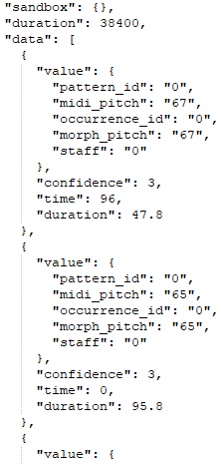
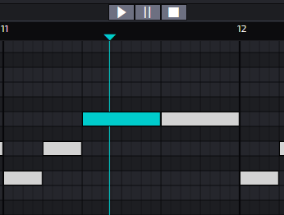
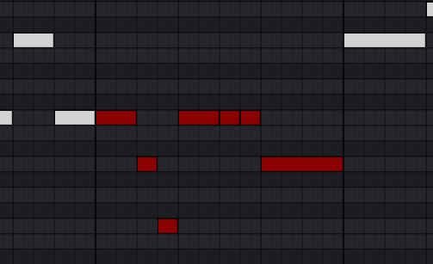
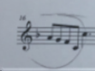
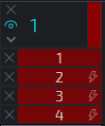
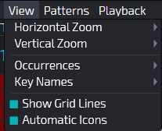
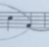
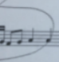
Methodology
Advantages over pen-and-paper methods:
Audio Playback
No Digitisation Time
Increased Precision
Quality-Of-Life Features
Notes:
We can already think of many advantages that a digital tool like ANOMIC would provide over pen-and-paper methods, right? For starters, it’s more precise. We know exactly which notes are part of an occurrence. It has audio playback, which is something you won’t get with pen-and-paper approaches unless you have some external playback somewhere or literally play the sheet music on an instrument yourself. The tool saves directly to a standardised digital format so we’re cutting down on the digitisation times, and it comes bundled with a bunch of quality-of-life features like automatic occurrence matching, MIDI channel selection, and interface customisation.

Slide 24
Evaluation
A user study was carried out to evaluate the tool.
A user study was carried out to evaluate the tool.
♪
♪
2763
occurrences of 788
patterns
2763
occurrences of 788
patterns
6
MIDI excerpts
26
participants
6
MIDI excerpts
26
participants
Notes:
Of course, a software tool on its own doesn’t constitute a thesis, so we also carried out a user study to generate some annotations with the tool, evaluate ANOMIC itself, and analyse the annotations made with it. The user study had 26 participants who annotated 2763 occurrences of 788 patterns across 6 excerpts of classical music in MIDI format.

Slide 25
Evaluation
Step 3: Survey
Step 3: Survey
Step 2: Annotation
Step 1: Instructions
exe
?
♪
Demographics
Musical background
ANOMIC usability metrics
Best and worst aspects
Feature recommendations
Comparison to pen-and-paper
Automatic occurrence matching
Demographics
Musical background
ANOMIC usability metrics
Best and worst aspects
Feature recommendations
Comparison to pen-and-paper
Automatic occurrence matching
ReadMe
Example MIDIs
Example JAMS
bach1.mid¹
bach2.mid
bee1.mid
hay1.mid
mo155.mid
mo458.mid
ANOMIC.exe
Dependencies
¹ I.Y. Ren et al., “Investigating musical pattern ambiguity in a human annotated dataset”, 2018
Notes:
This user study was split into a few steps. The first step was orientation, where we had users read a set of instructions explaining basically what a musical pattern is and what we want them to do. Then, they were prompted to download a ZIP file with some help documentation, a list of MIDI files to annotate, and the executable of the tool itself. The MIDI file excerpts were taken from an existing study that partially inspired this thesis to begin with, which is called Investigating Musical Pattern Ambiguity in a Human-Annotated Dataset. Over there, they use the pen-and-paper manual annotation approach to annotate and analyse the six MIDI excerpts that you can see in the slide.
Finally, they were asked to take a survey that queried them on their demographics, musical background, and what they thought of the tool and its features.

Slide 26
Evaluation
Participants had no time limit to complete the annotation task.
Participants were unsupervised.
User actions within ANOMIC were logged with timestamp included.
Studies that were performed:
How inter-annotator agreement compares with existing work (the HEMAN data set)¹ and how it varies with factors like usage of automatic occurrence matching or musical experience.
Analysis into the survey responses.
Participants had no time limit to complete the annotation task.
Participants were unsupervised.
User actions within ANOMIC were logged with timestamp included.
Studies that were performed:
How inter-annotator agreement compares with existing work (the HEMAN data set)¹ and how it varies with factors like usage of automatic occurrence matching or musical experience.
Analysis into the survey responses.
¹ I.Y. Ren et al., “Investigating musical pattern ambiguity in a human annotated dataset”, 2018
Notes:
Participants of the user study had no time limit and were unsupervised, because the user study was carried out entirely online. To help gather more data, every time a user did something in ANOMIC, the action was logged and timestamped, and using all this data of annotations, survey responses, user action logs, and timestamps, we were able to perform a few studies.
The first set of studies looks into inter-annotator agreement, which is basically us trying to quantify how well annotators agreed with each other overall. We’ll look into how it compares to another data set called the HEMAN data set, which is the data prepared and analysed in the paper I mentioned, and we’ll also look into how inter-annotator agreement varies with factors like usage of the automatic occurrence matching feature or musical background.
The second set of studies is taking a look at the survey responses and what people thought about the tool.

Slide 27
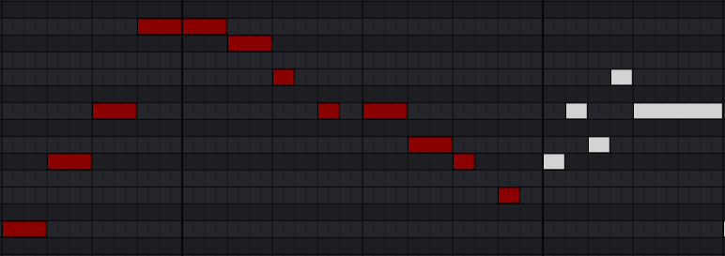

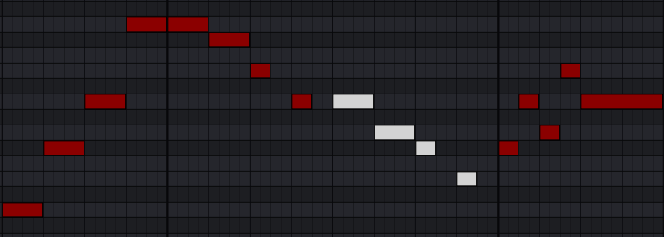
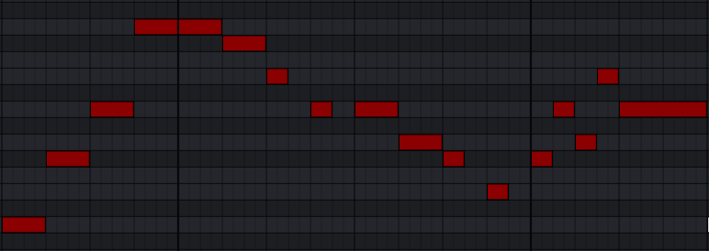

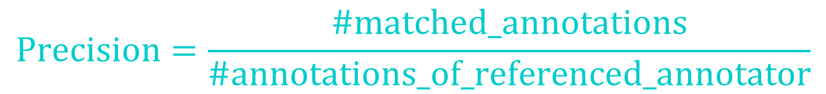
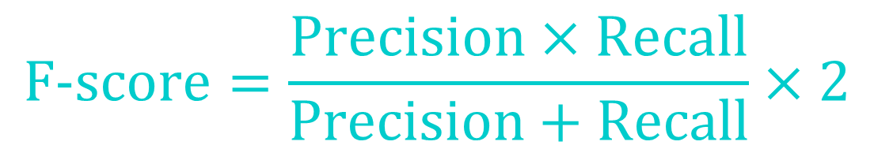

Evaluation
Inter-Annotator Agreement
First method: Interval agreement¹
Second method: Note-level agreement
First method: Interval agreement¹
$$Precision=\frac{\#matched_annotations}{\#annotations_of_referenced_annotator}$$
1
Compare with threshold to determine agreement
$$Recall=\frac{\#matched_annotations}{\#annotations_of_current_annotator}$$
$$F\text{−}score=\frac{Precision×Recall}{Precision+Recall}×2$$
2
¹ I.Y. Ren et al., “Investigating musical pattern ambiguity in a human annotated dataset”, 2018
¹ I.Y. Ren et al., “Investigating musical pattern ambiguity in a human annotated dataset”, 2018
Notes:
So what does it mean for annotators to agree with each other? In the thesis we used two different techniques to calculate this metric. The first one we’ll call the interval agreement method. This is best explained by an example. Let’s say we have annotator 1 and annotator 2. They’re both separate people that annotated patterns in the music, and in one case, we see that they annotated a segment of the music in a fairly similar way. Annotator 1 annotated up till the last bar line in that snippet, whereas annotator 2 annotated all the notes in the snippet.
To figure out whether these two agree on this pair of annotations, we take the interval of each annotator’s occurrence, which is basically the start and end of each occurrence. We subtract the intervals to find the difference between them, and this difference is compared to a threshold. If the difference is smaller than the threshold, then the two occurrences agree with each other. If they’re larger than the threshold, then they disagree on that pair of occurrences.
This process is done on every pair of occurrences on every pair of annotators, and value are computed based on the number of annotation matches recorded and the total number of annotations. These precision, recall, and F-score values are standard values used when evaluating this kind of task. So this method is pretty good for calculating agreement, but it comes with a few problems that we identified. Firstly, it can’t handle gaps in the middle of pattern occurrences. In ANOMIC we don’t impose a restriction that patterns need to be contiguous, so you could have a pattern with a gap in it, and the interval agreement metric would say that it agrees perfectly with the same pattern with no gap, just because for that metric, the only thing that matters is the start and end time of the annotation.
Also, it doesn’t handle multiple notes playing at the same time very well either. As you can see on the right, it will say that these two annotations agree with each other, even though the bottom one didn’t annotate the same notes that the top one annotated.
Finally, this is pretty much a black-or-white way of figuring out agreement between annotations. Either two annotations agree or they don’t. For the purposes of analysing agreement, a metric that is able to say how much or how little two annotations agree might be more descriptive.

Slide 28
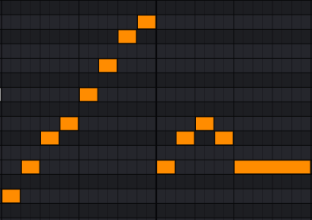
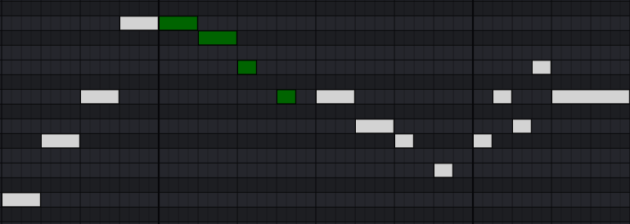
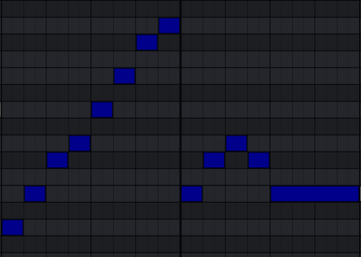
Evaluation
Inter-Annotator Agreement
Second method: Note-level agreement
Agreement:
1
Matches:
12
70.6%
23.5%
=
100%
Matches: 1
Matches: 2
Matches: 3
Matches: 4
Matches: 5
Matches: 7
Matches: 8
Matches: 9
Matches: 10
Matches: 11
Matches: 12
Matches: 6
Matches: 0
0%
0%
0%
=
Total:
Total: 17
17
85.3%
2
= 70.6%
Notes:
So that’s where we introduce a new metric of agreement that I’m going to call the note-level agreement. Instead of using time intervals, this operates on a note-by-note basis. Here’s how it works.
Once again, we’ve got the same pair of annotations done by the same pair of annotators. We start by iterating through the notes in the larger annotation. That would be the bottom one, right? It has more notes. So for each note, we see if there’s an exact match in the top annotation. Starting with the first, there’s a match. The second also has a match. We keep going on and on and hit 12 matches. But for the final five notes, it doesn’t find a match, because annotator 1 didn’t include those in his annotation. So we get the 12 matches and divide it by the total number of notes in the larger annotation, giving us 70.6% agreement.
That just gives us the agreement between two occurrences, though, and we want the agreement between two annotators, so we repeat this process for every pair of annotations between the two annotators, saving each result in a sort of agreement matrix. Then, we take the max of each row in a mutually exclusive way, which means we’re assigning the most agreeing pairs of annotators to each other, and we take the average of the agreement values of these assignments, which means that annotator 1 and 2 agree with each other with a factor of 85.3%.
So that’s how the inter-annotator agreement is computed. Now we can look at results!

Slide 29
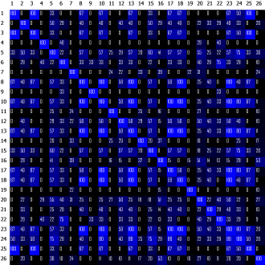
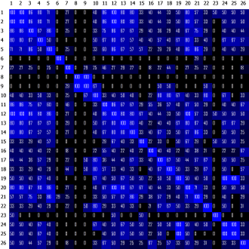
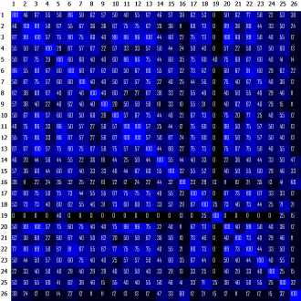
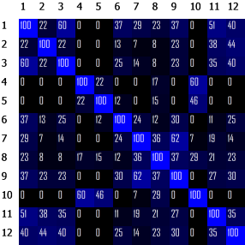
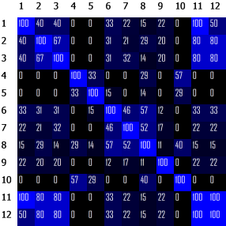
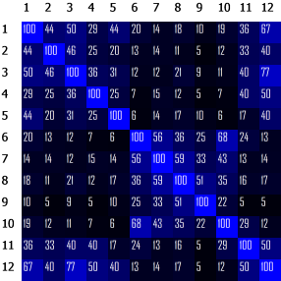
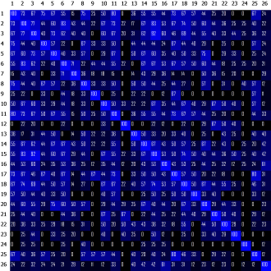
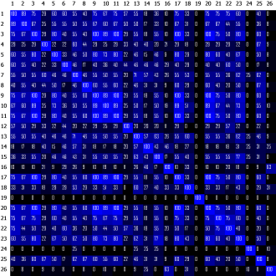
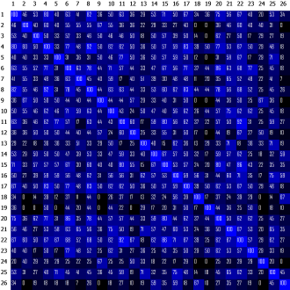
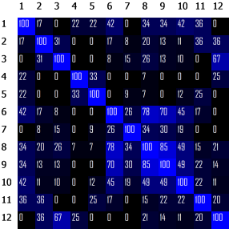
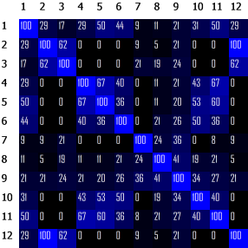
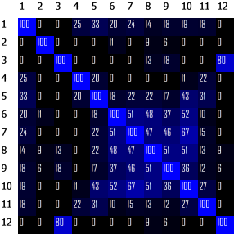
Agreement Results
Interval agreement was compared on the HEMAN data set and on the ANOMIC data set.
Interval agreement was compared on the HEMAN data set and on the ANOMIC data set.
ANOMIC |  | HEMAN
File | Agr | File | Agr
bach1 | 0.28 | bach1 | 0.25
bach2 | 0.38 | bach2 | 0.31
bee1 | 0.48 | bee1 | 0.32
hay1 | 0.36 | hay1 | 0.26
mo155 | 0.4 | mo155 | 0.29
mo458 | 0.45 | mo458 | 0.24
Avg | 0.39 | Avg | 0.28
Dev | 0.07 | Dev | 0.03
HEMAN
ANOMIC
HEMAN
ANOMIC
Findings:
Inter-annotator agreement was 39.3% higher in ANOMIC’s annotations than HEMAN’s.
Agreement values follow similar trends: bach1.mid showed among the least agreement in both data sets and bee1.mid showed among the most agreement.
Findings:
Inter-annotator agreement was 39.3% higher in ANOMIC’s annotations than HEMAN’s.
Agreement values follow similar trends: bach1.mid showed among the least agreement in both data sets and bee1.mid showed among the most agreement.
Notes:
The interval agreement was used mainly to have a more direct way of comparing between the annotations we got from ANOMIC’s user study and the HEMAN annotations that were done for the paper I talked about earlier. Here are the results. They show up as agreement matrices, where the value at index i, j indicate how much annotator i agrees with annotator j using the interval agreement method. They’re colour coded too, so the lighter the colour, the more they agreed. Obviously, the diagonal of the matrix is fully blue or fully 100, because everyone agrees with themselves perfectly.
The table on the right shows the matrix values averaged to get an overall agreement value for each file, along with average and standard deviation for the entire body of annotations at the bottom. The left side of the table is ANOMIC’s agreement values and the right side is HEMAN’s agreement values. We can immediately see that the annotations done with ANOMIC agree with each other a lot more than the HEMAN annotations done with pen and paper, by a factor of 39.3%. We also see that the agreement follows similar trends. For both data sets, bee1 showed the most agreement and bach1 showed among the least agreement, probably because bee1 was a short and easy musical excerpt with obvious musical patterns while bach1 was a long excerpt with musical phrase structure that’s difficult to follow.

Slide 30
Agreement Results
Note-level agreement was used to compare inter-annotator agreement between musicians and non-musicians.
People were categorised based on survey responses.
Note-level agreement was used to compare inter-annotator agreement between musicians and non-musicians.
People were categorised based on survey responses.
MUSICIANS |  | NON-MUSIC
File | Agr | File | Agr
bach1 | 49% | bach1 | 36%
bach2 | 50% | bach2 | 57%
bee1 | 70% | bee1 | 66%
hay1 | 53% | hay1 | 47%
mo155 | 62% | mo155 | 47%
mo458 | 61% | mo458 | 46%
58%
50%
58%
50%
Musicians
Musicians
Non-Musicians
Non-Musicians
Notes:
Next, we use note-level agreement for further studies. We used the questions on musical background in the survey to segregate the participants to musicians and non-musicians, where musicians are people that state they have musical background, can play an instrument, etc, and non-musicians are the people that comparatively have little to no musical background. These are the results, with musicians on the left and non-musicians on the right. We can see that musicians agreed more with each other on every single excerpt, except bach2.mid. Now we couldn’t figure out a particular reason for this, but it’s a pretty curious outlier.
Overall, if we had to average the values, we can see that musicians have an overall inter-annotator agreement average of 58% compared to non-musicians’ 50%, which shows that musicians tend to agree with each other more on musical patterns.

Slide 31
Agreement Results
Note-level agreement was also used to investigate correlation between agreement and usage of automatic occurrence matching.
People were categorised based on user action logs.
Findings:
People who used the automatic occurrence finder more tended to agree less.
However, removing the outliers and recalculating averages shows that the feature slightly improves agreement.
Notes:
Finally, we take a look at one of ANOMIC’s prominent features, the automatic occurrence matching. We computed how many times each person used the automatic occurrence matching feature, as in the one where you can right-click and automatically find exactly-repeating occurrences. These are the results. As you can see, annotator 16 and especially annotator 26 used the feature much much more than everyone else, with annotator 26 clicking the button almost 250 times.
We categorised people once again by segregating the participants based on how much they used the automatic occurrence matching feature, and found that people that used the feature more tended to agree less. However, if we remove the two outliers I mentioned and recalculate the agreement, we find that the feature slightly improves agreement.
What does this tell us? Well, I looked at the actual annotations of the two outliers, and it seems like they somewhat abused the feature. They would annotate very tiny collections of notes, like two or three notes, and then try and get as many hits as they can using the automatic finder. This of course isn’t the intended usage of the tool, so what ended up happening was they agreed very little with everyone else and ended up being such outliers. What we learn from this is that the automatic occurrence finder can be a helpful feature, but it can’t be abused in this way.

Slide 32









Survey Results
Participants rated ANOMIC on usability metrics using a Likert scale.
Participants rated ANOMIC on usability metrics using a Likert scale.
3.96
3.96
3.65
3.46
3.42
3.96
3.96
3.65
3.46
3.42
Learnability
Performance
Productivity
Accessibility
Learnability
Performance
Productivity
Accessibility
User-friendliness
User-friendliness
3.65
3.96
3.04
3.62
3.65
3.96
3.04
3.62
Information scent
Flow
Customisation
User engagement
Information scent
Flow
Customisation
User engagement
Notes:
Lastly, we can take a look at the survey results. Participants were given a Likert scale, which is one of those ranges of numbers where, for example, 1 means strongly disagree and 5 means strongly agree, and were given a set of statements to do with standard usability metrics for the tool. We looked into the following questions:
How easy is the tool to learn?
How easy is it to perform tasks on?
How productive and scalable is ANOMIC?
How accessible is the software for different varieties of users?
How user-friendly is the interface?
Was everything in the interface easy to find?
How well does the tool flow from one action to another?
How customisable is the tool to the user’s needs?
How well does it engage users?
The final scores out of five based on the Likert scale survey responses are here on the screen now. We can see that for the most part we’re scoring pretty well among users, with the exception of customization which is at around 3 out of 5, meaning people probably expected some more ways of customising the tool to their needs.

Slide 33
Survey Results
Findings:
Out of 26 participants, 17 stated that they would prefer to annotate music on ANOMIC than on a traditional pen-and-paper approach. 4 participants said they would prefer the traditional approach.
ANOMIC was criticised for lack of tool-tips / help menu, minor interface issues, lack of features such as automatic scrolling during playback and occurrence editing, and occasional bugs/crashes.
The tool was praised for its ease of use, quality-of-life features, and clean interface.
Notes:
What else does the survey tell us? Well, out of 26 participants, 17 said they’d outright prefer ANOMIC to pen-and-paper annotation and only 4 said that they preferred the traditional approach. These 4 people also said they were all able to read sheet music, so this is possibly a case of people being less inclined to leave their comfort zone and try the digital piano roll interface.
ANOMIC was criticized for a lack of tool-tips and help documentation, some minor interface issues like the interface being hard to navigate using a mouse, and a lack of certain features that could make the tool easier or smoother to use. On the other hand, it was praised for its ease of use, clean and modern interface, and quality-of-life features like the playback and automatic occurrence finding.

Slide 34
Conclusion
Patterns are short, repeated musical segments that have significant application in music research.
Humans seem to be the best pattern annotators, but human annotations are currently scarce and not fully understood.
In this project, we introduced a novel software, ANOMIC, that can allow users to annotate musical patterns.
A user study evaluated the tool and annotations created with it. The reception was positive among users, and it was found that inter-annotator agreement was comparable to previous work using traditional pen-and-paper approaches.
The hope is that the findings and software presented can help further MIR research.
Notes:
Time to wrap things up. To recap, musical patterns are short, repeated musical segments that are said to have significant application in the research. Humans seem to be better at annotating them, but human patterns are scarce and not fully understood. We introduced a novel software called ANOMIC to help alleviate these issues, and performed research and evaluation around the tool. We found that inter-annotator agreement was comparable to previous work and that reception among users was positive.
The hope is that the findings and software we’ve presented here can help further research in music information retrieval.

Slide 35
Future Work
Make a more direct comparison between ANOMIC and pen-and-paper, especially on time taken in both approaches (including time taken to digitise).
Use annotations created with the tool in MIR applications and research.
Further develop the tool and add more features:
Fix bugs, optimise performance, clean up code, add documentation.
Add sheet music annotation support.
Allow editing and customisation of the interface, patterns, and occurrences.
Support more MIDI instruments.
Add more quality-of-life features like auto-scrolling during playback, shortcut keybinds, native filetype for saving annotation projects, etc.
Notes:
Before finishing, I wanted to talk a bit about future work and what other work we can do to improve the tool and the research.
To begin with, I think one thing that really needs to be done is a more direct comparison between ANOMIC annotation and pen-and-paper annotation. We do compare inter-annotator agreement with the HEMAN data set, but that paper had a slightly different annotation task to ours. While we said to annotator patterns and every occurrence of each pattern, in the previous paper with the HEMAN data set people were simply asked to annotate important motifs in the music, without necessarily annotating their repetitions.
This made a direct comparison difficult, since every pattern in ANOMIC’s data has many different occurrences that annotators might or might not agree on. To make the comparison more possible, we imposed a rule that if at least one pair of occurrences between two patterns agrees in ANOMIC’s data, then the two patterns agree. On the other hand, HEMAN’s data doesn’t have this abstraction of patterns and occurrences, so we didn’t have that rule in place. What this all means is that that two patterns in our data have more chances to agree with each other than in the HEMAN data, which potentially biases the agreement values in our favour.
We also have no direct time comparison between the two techniques. Being able to say that ANOMIC cuts down on annotation time due to not needing any manual digitisation would be a very strong argument in favour of digital annotation, but because of time constraints and worries that we wouldn’t get enough participants, we couldn’t quite get any data on how long people would take to annotate this music using pen-and-paper to be able to compare.
Of course, using these patterns that we found in the user study for actual music information retrieval is the ultimate goal, so another great avenue of future work would be to use the data set we made here in practice for a classifier or similarity metric or any other application.
Finally, there is more to develop with ANOMIC itself. There’s the general housekeeping that needs to be done, like fixing any bugs that might’ve slipped through the cracks, optimising tool performance, cleaning up code, adding documentation, and so on. A big feature is also allowing people to annotate on sheet music as well. There’s more to be done to make the interface, patterns, and occurrences easier to edit and customise. We can support more MIDI instruments than just a piano. And finally, we can add more features like auto-scrolling the song during playback, keybinds, a native filetype for saving project files, and so on.

Slide 36
QUESTIONS?
Contact Me
s.b.wells@students.uu.nl
ANOMIC Instructional Video
tinyurl.com/annotationtoolvideo
ANOMIC GitHub Repository
tinyurl.com/annotationtoolrepo
Notes:
So, that pretty much covers it! On this slide there are some links to the code repo and an instructional video I set up for using ANOMIC. You can also feel free to contact me about anything using my university email. Are there any questions?

